Slide 1
Multiple mvcs 44643 mobile Computing – iOS
Instructor: Dr. Chandra Mouli
Northwest Missouri State University

Slide 2
Table of contents
Introduction
UITabBarController
UISplitViewController
UINavigationController
View assembly
Accessing the sub-MVCs
Segues
Preparing for a Segue
Conclusion

Slide 3

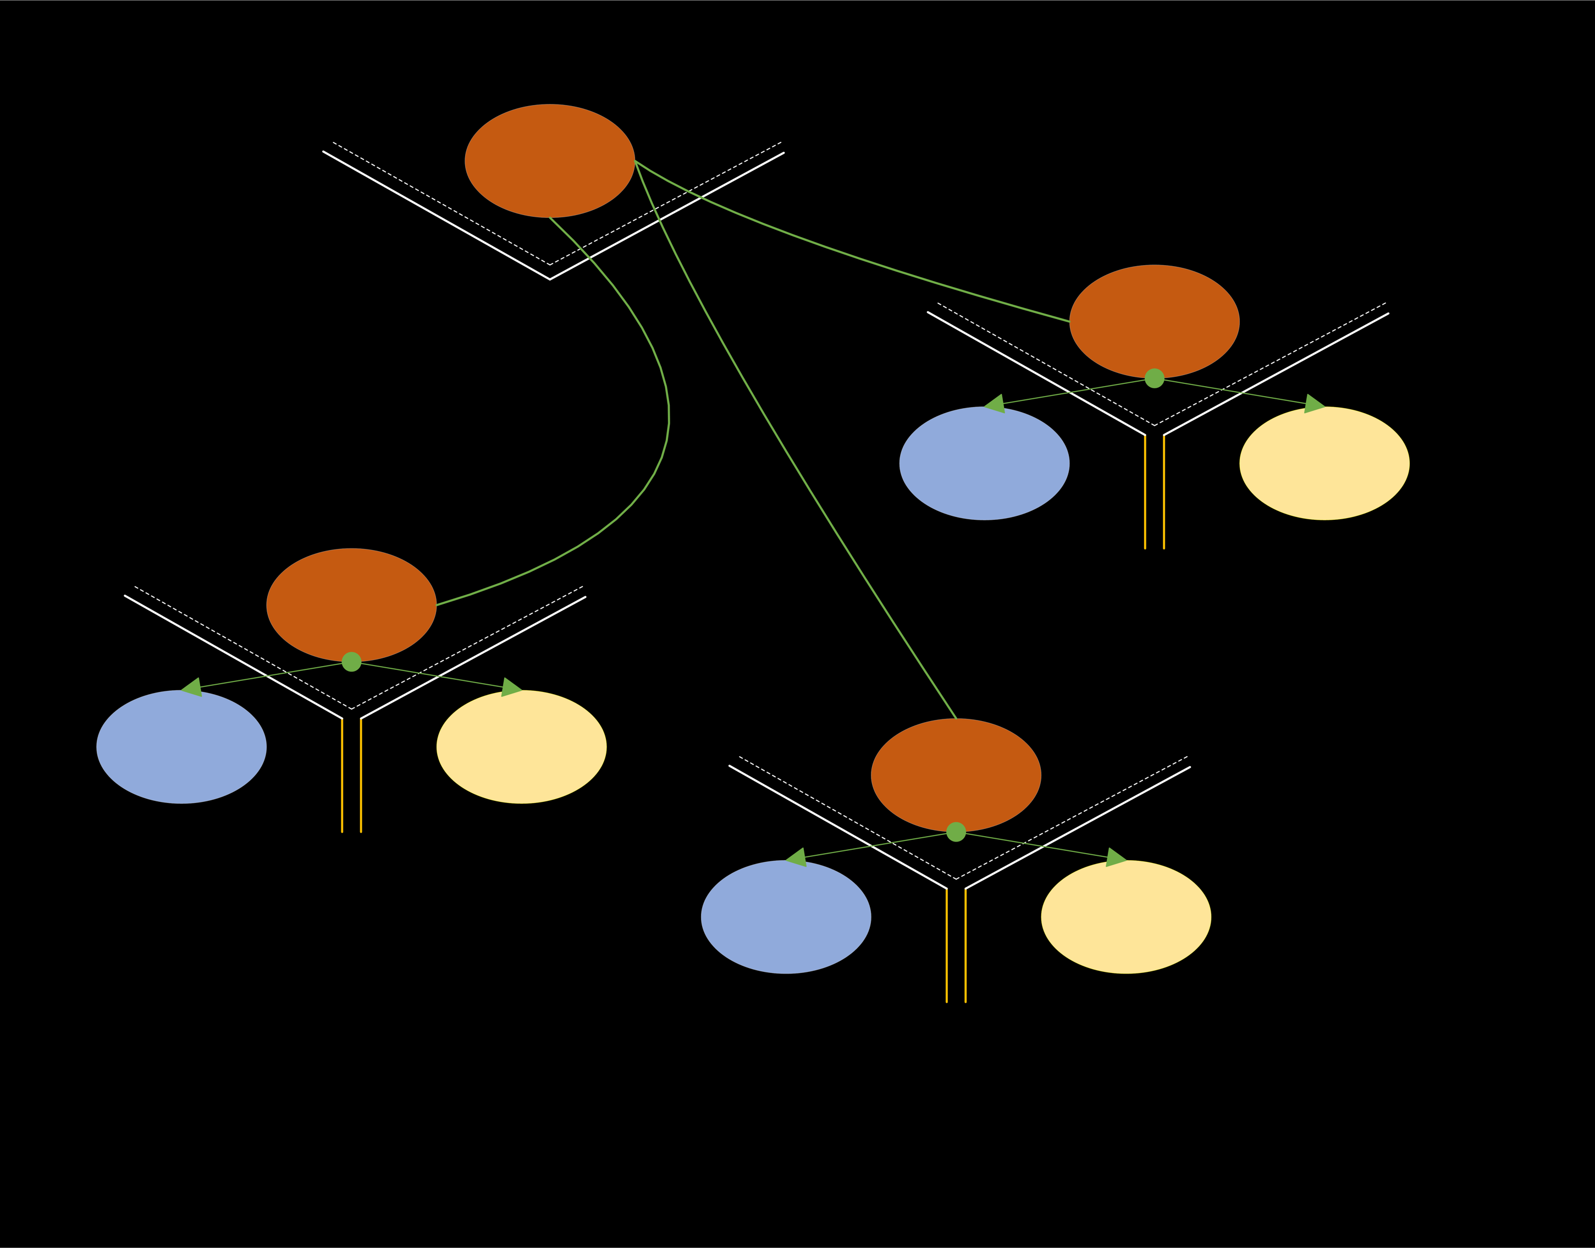
Introduction
iOS provides some Controllers whose View is other MVCs.
We can also build our own Controllers to do this.
Examples:
UITabBarController
UISplitViewController
UINavigationController

Slide 4
UITabbarcontroller
Use to choose between different MVCs.
Using an MVC’s tabBarItem property, we can set its title, icon, badge, etc. However, we do it via storyboard as well.
var tabBarItem: UITabBarItem!
Usually, 4 or 5 tabBar items.

Slide 5
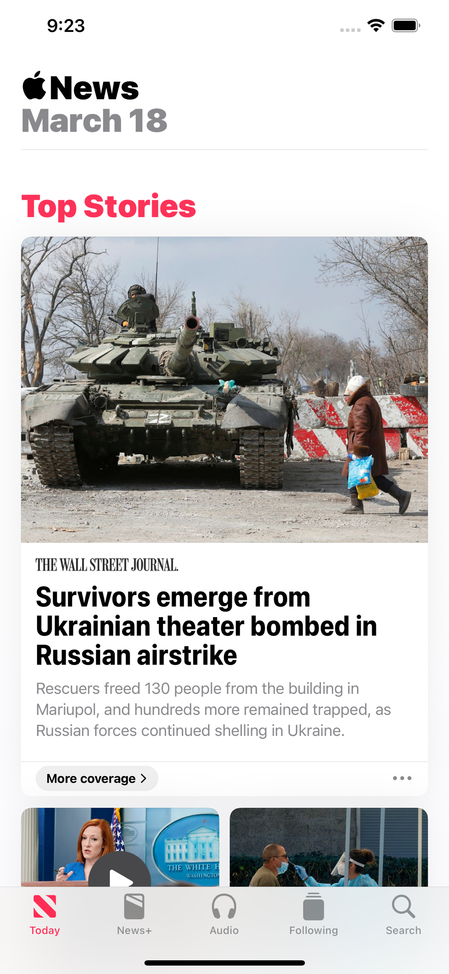
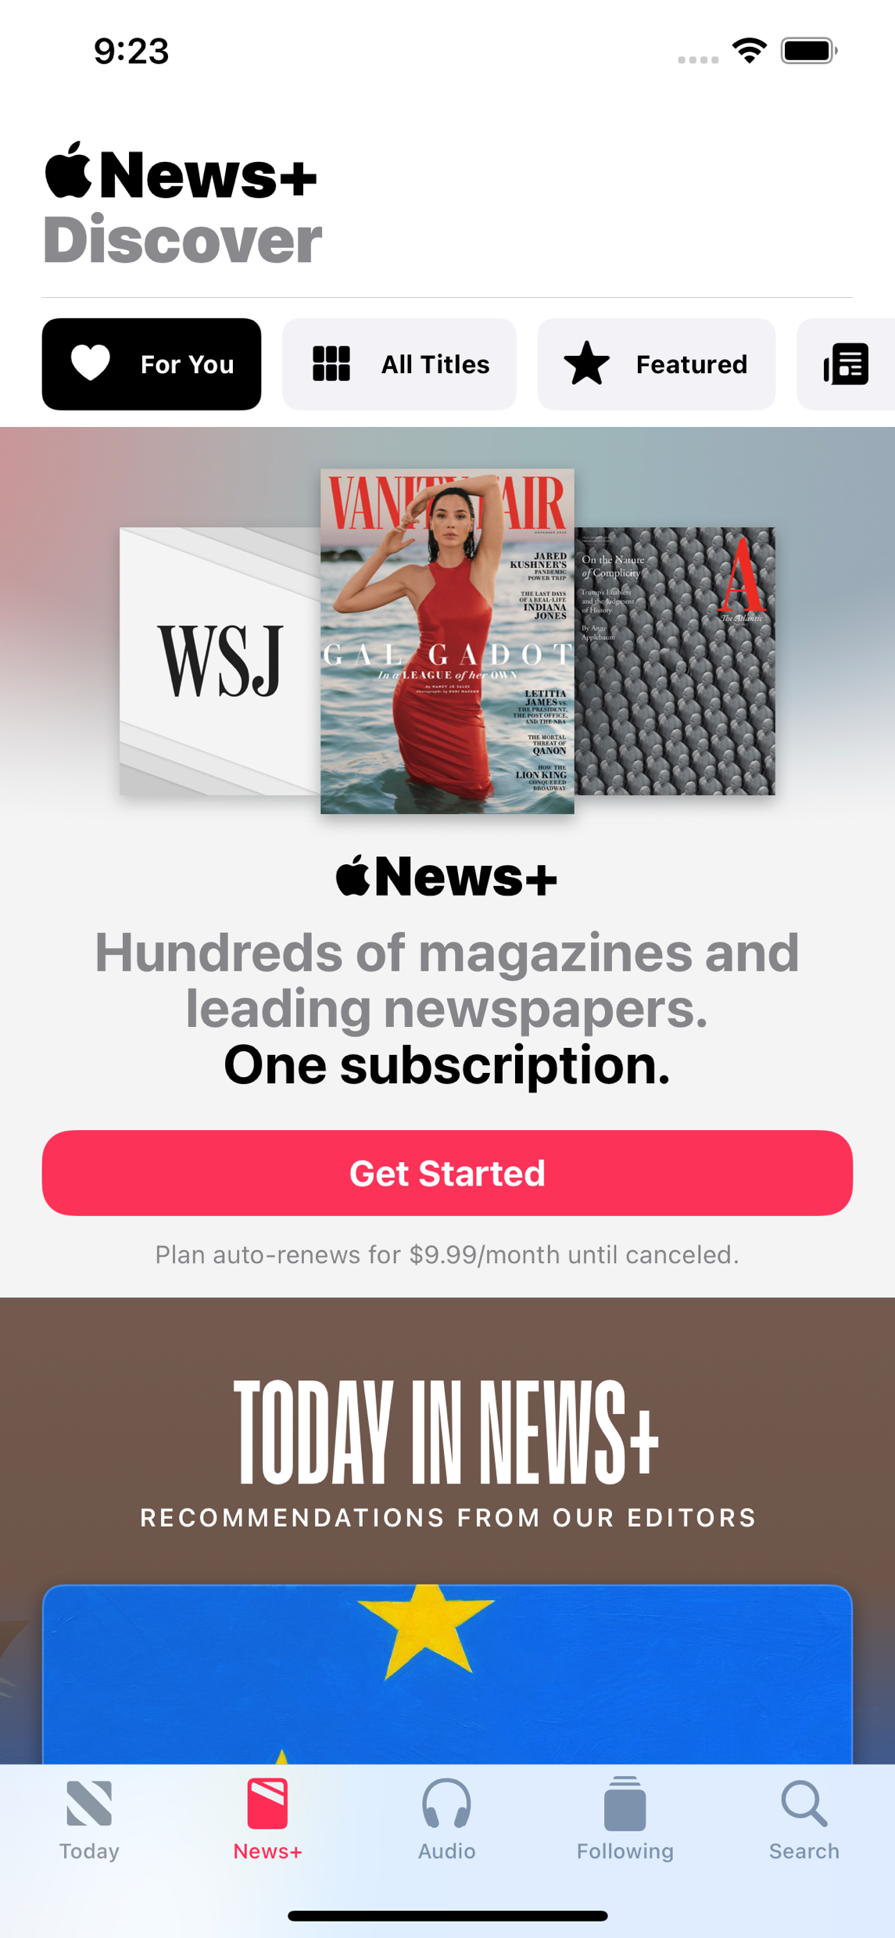
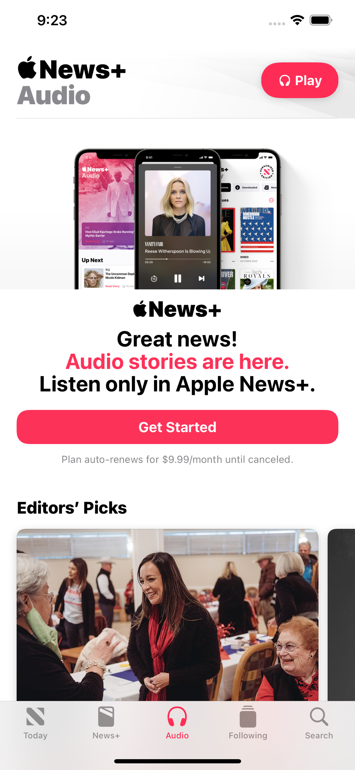
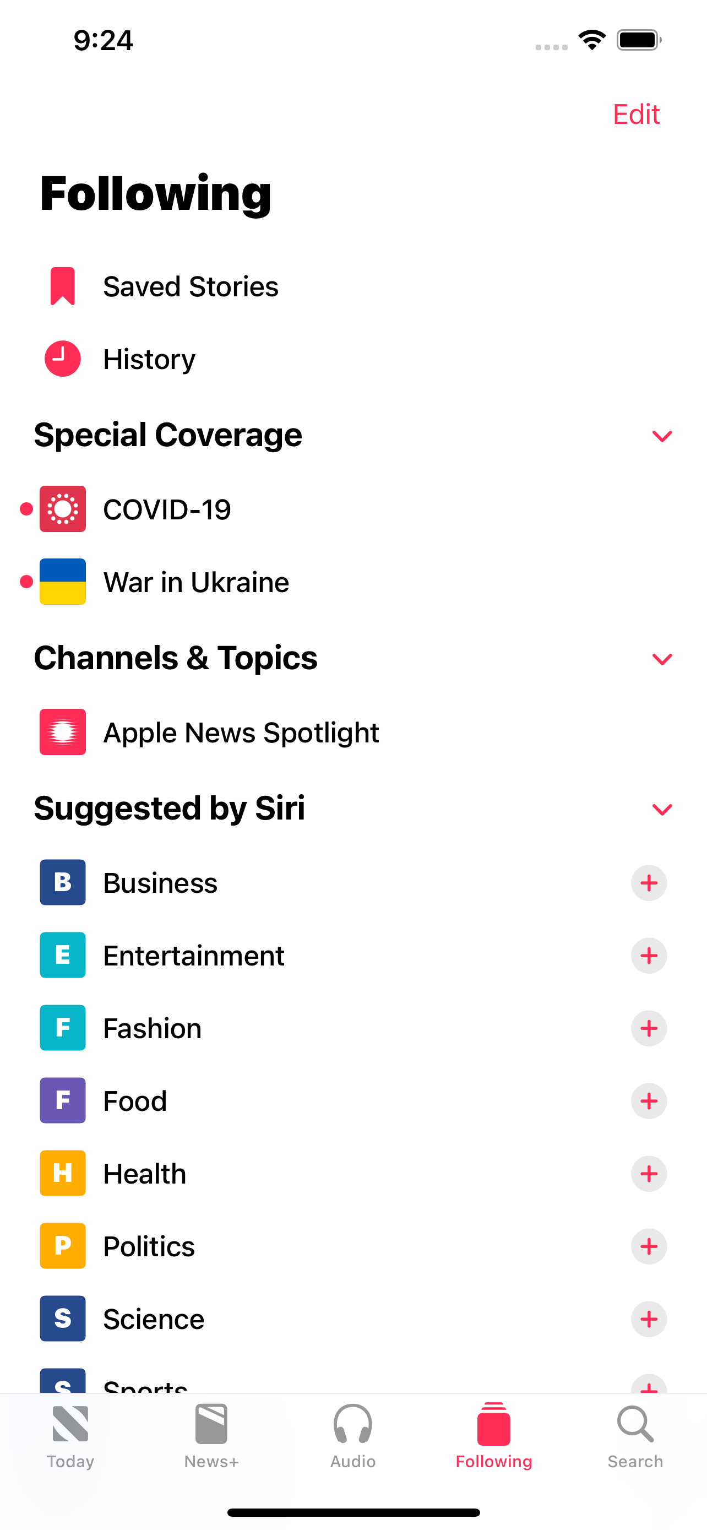
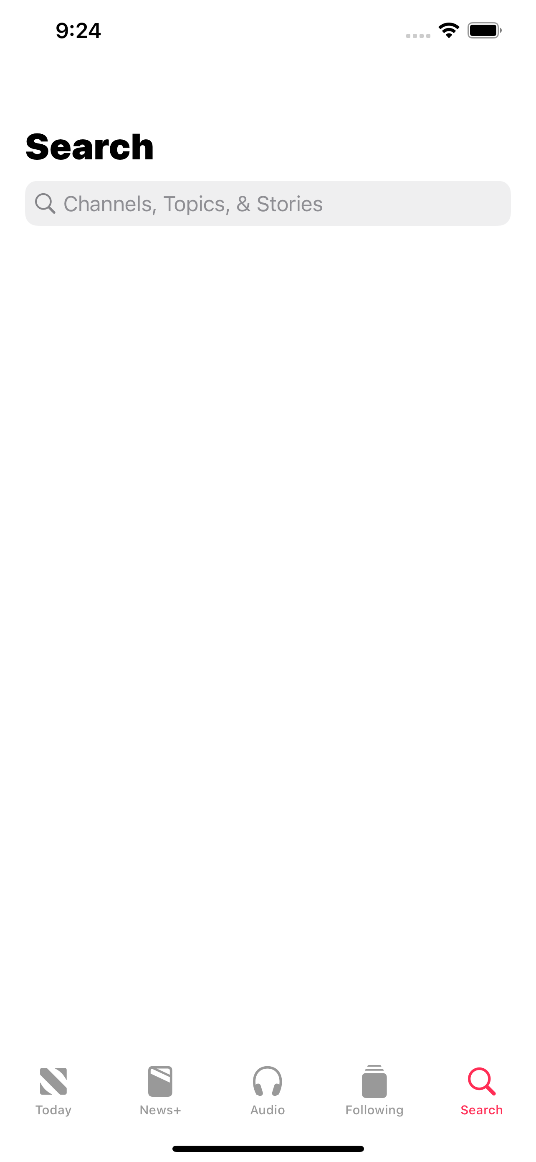
UITabbarcontroller

Slide 6
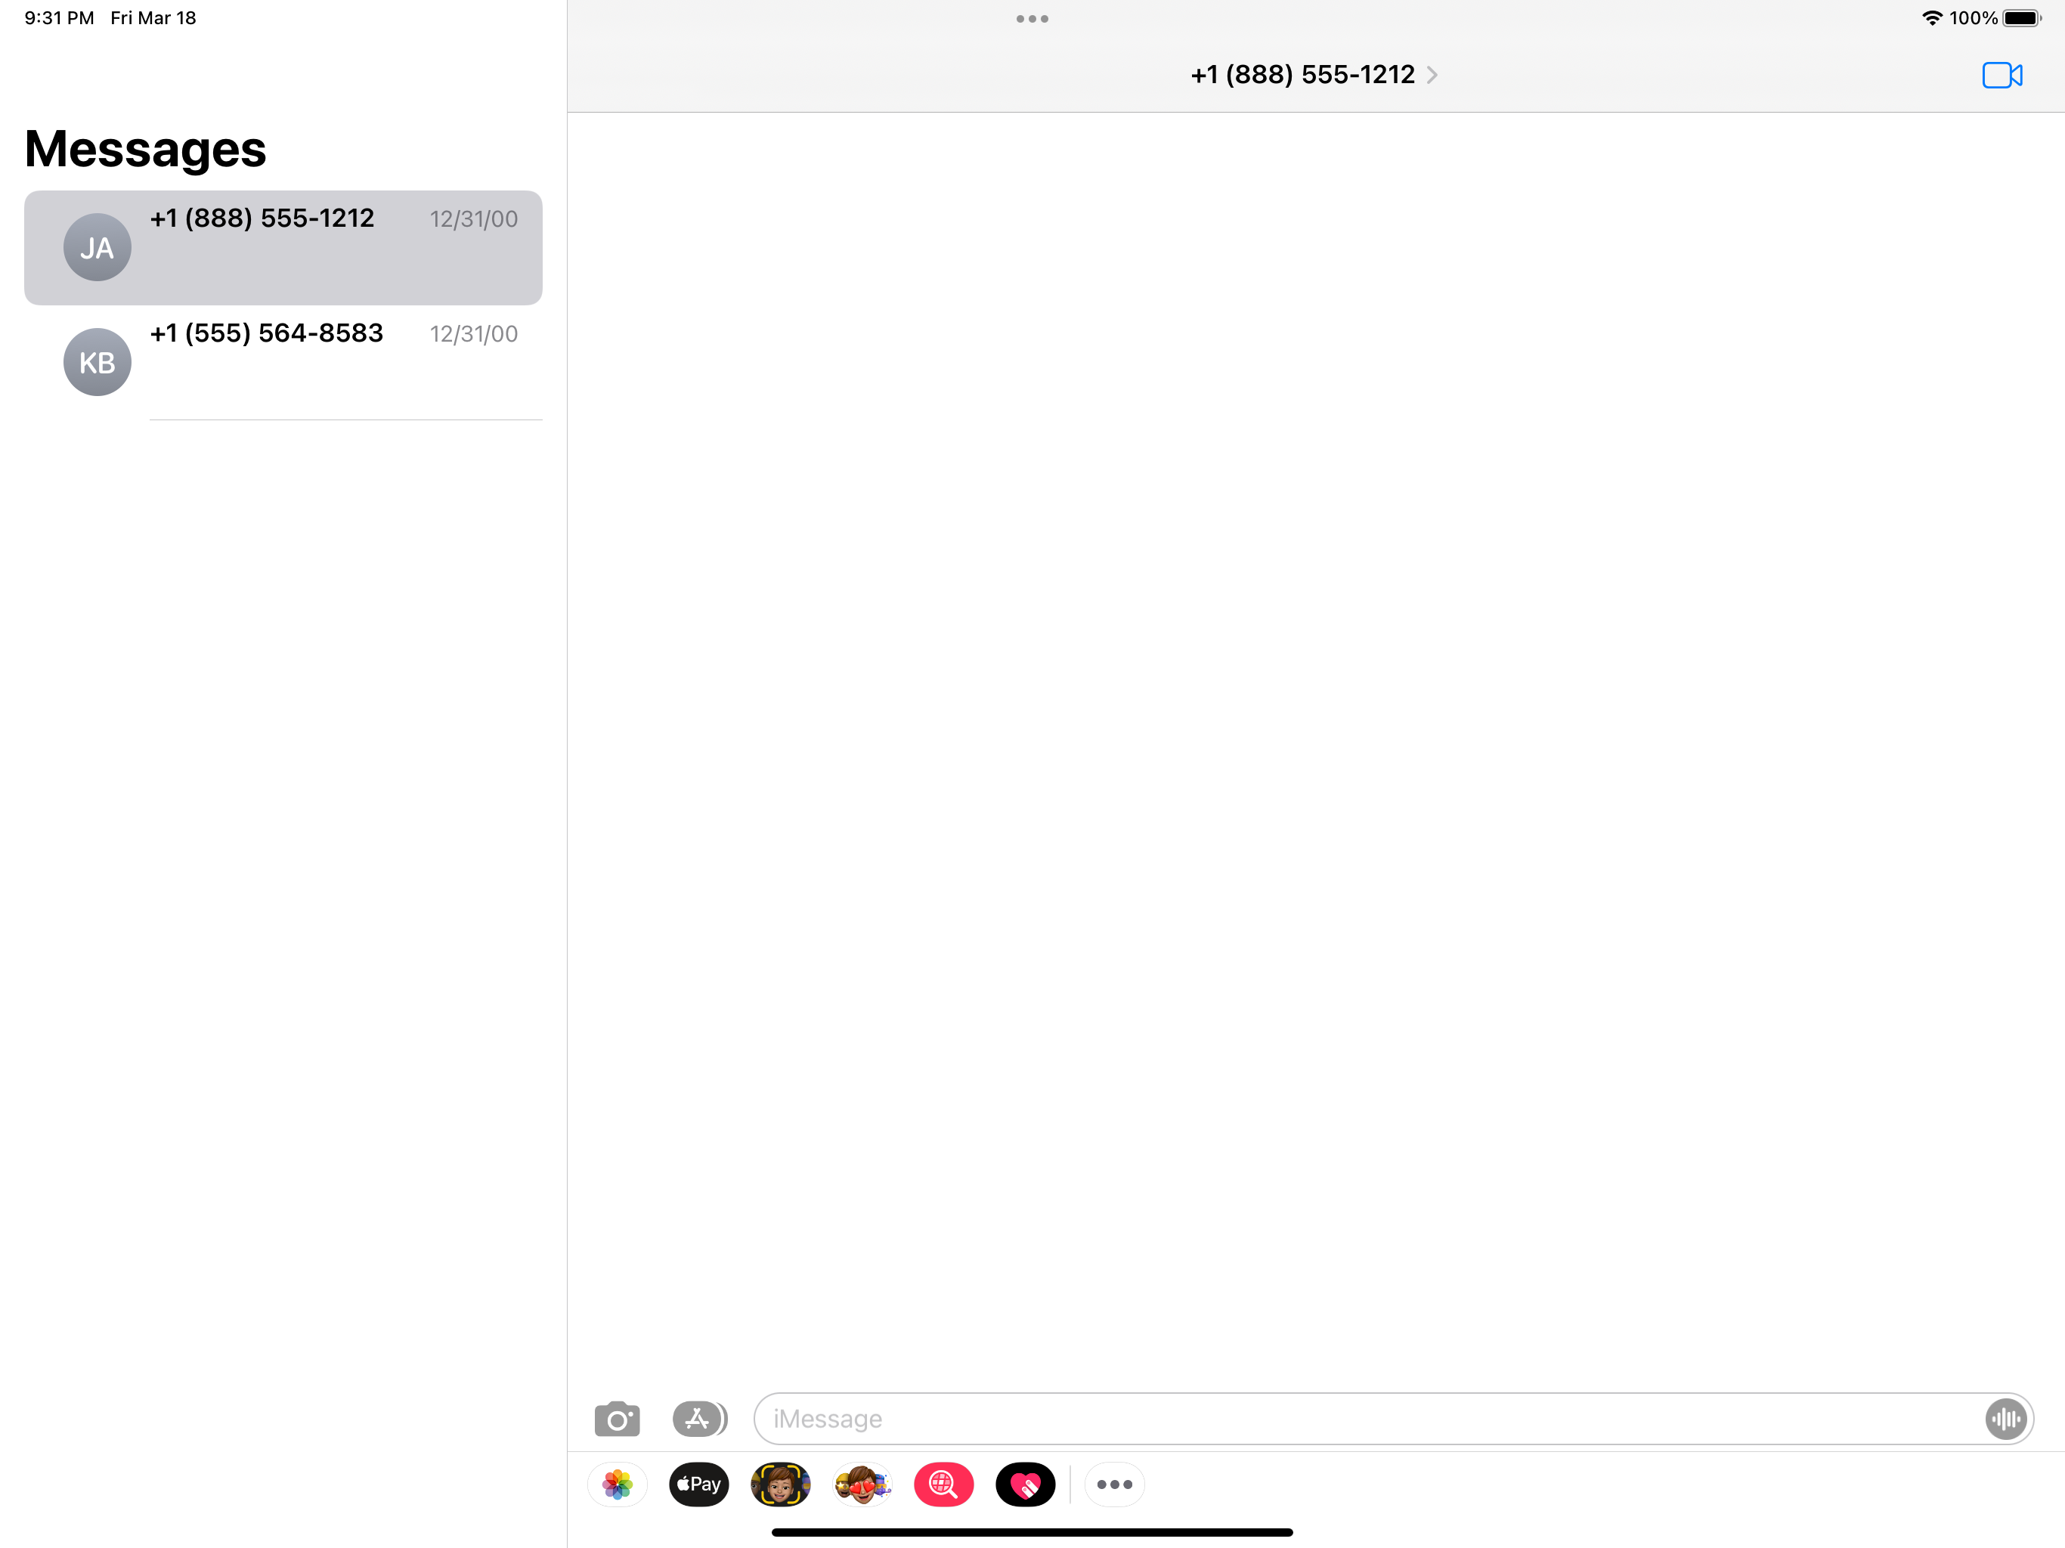
UISplitViewController
It puts two MVCs side-by-side.
Master and Detail views.
Works well with iPads and plus versions of iPhones.
Double or triple column styles.

Slide 7
UINavigationController
It pushes and pops MVCs off of a stack.
Use a MVC’s UIViewController’s navigationItem property to design navigation controller’s top area.

Slide 8
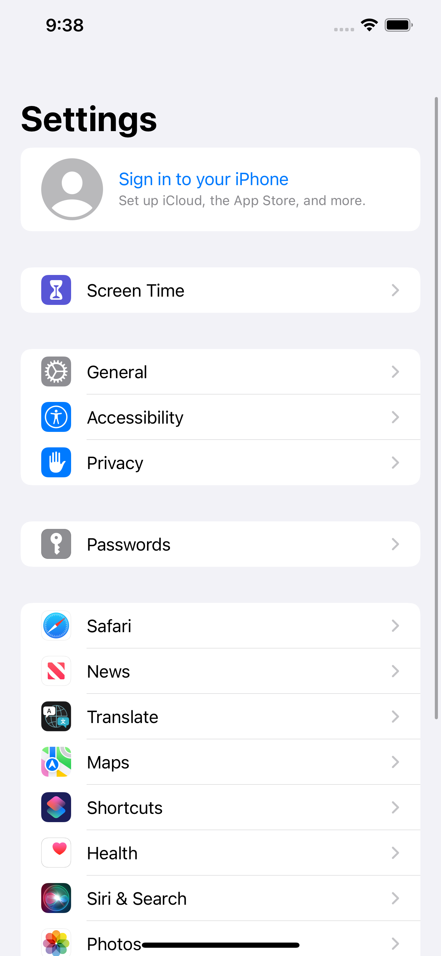
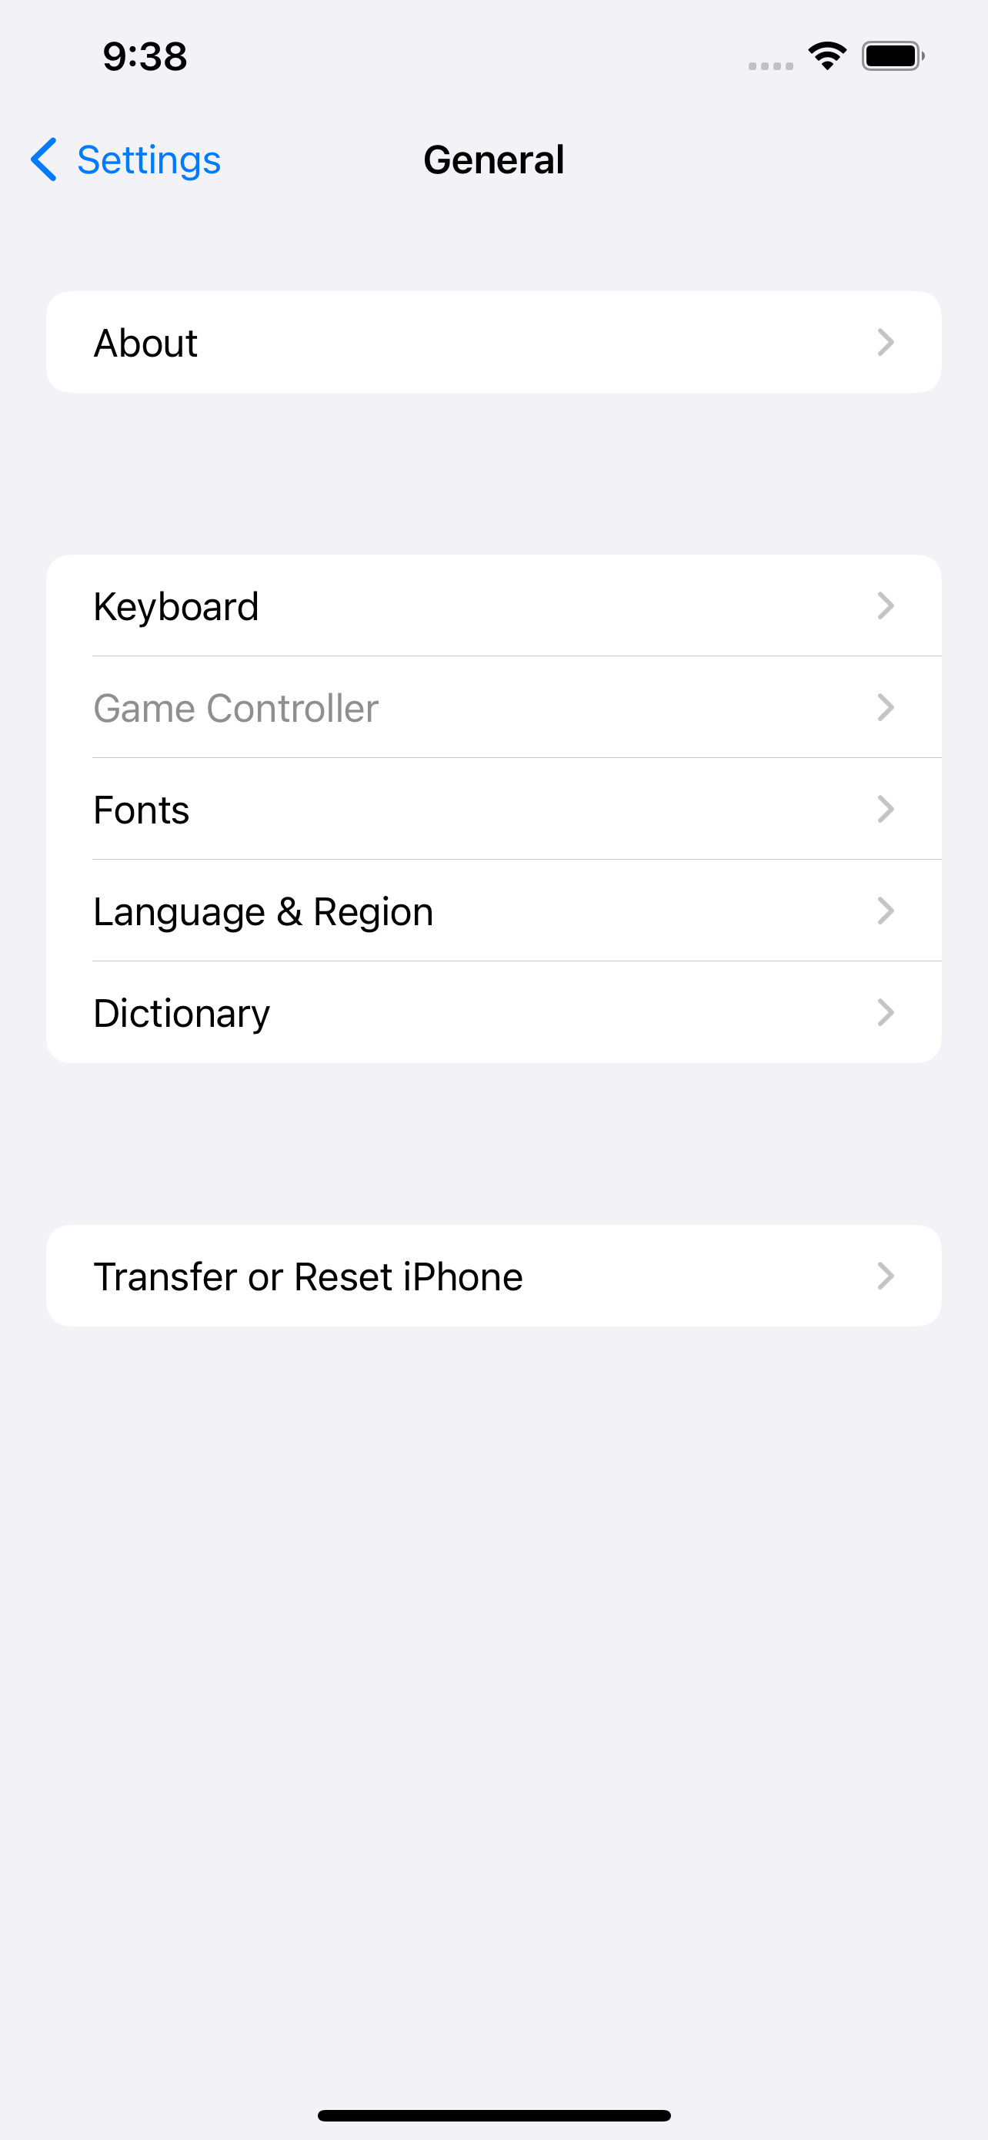
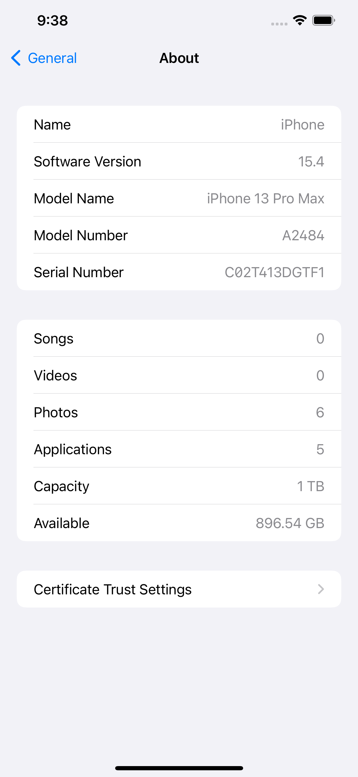
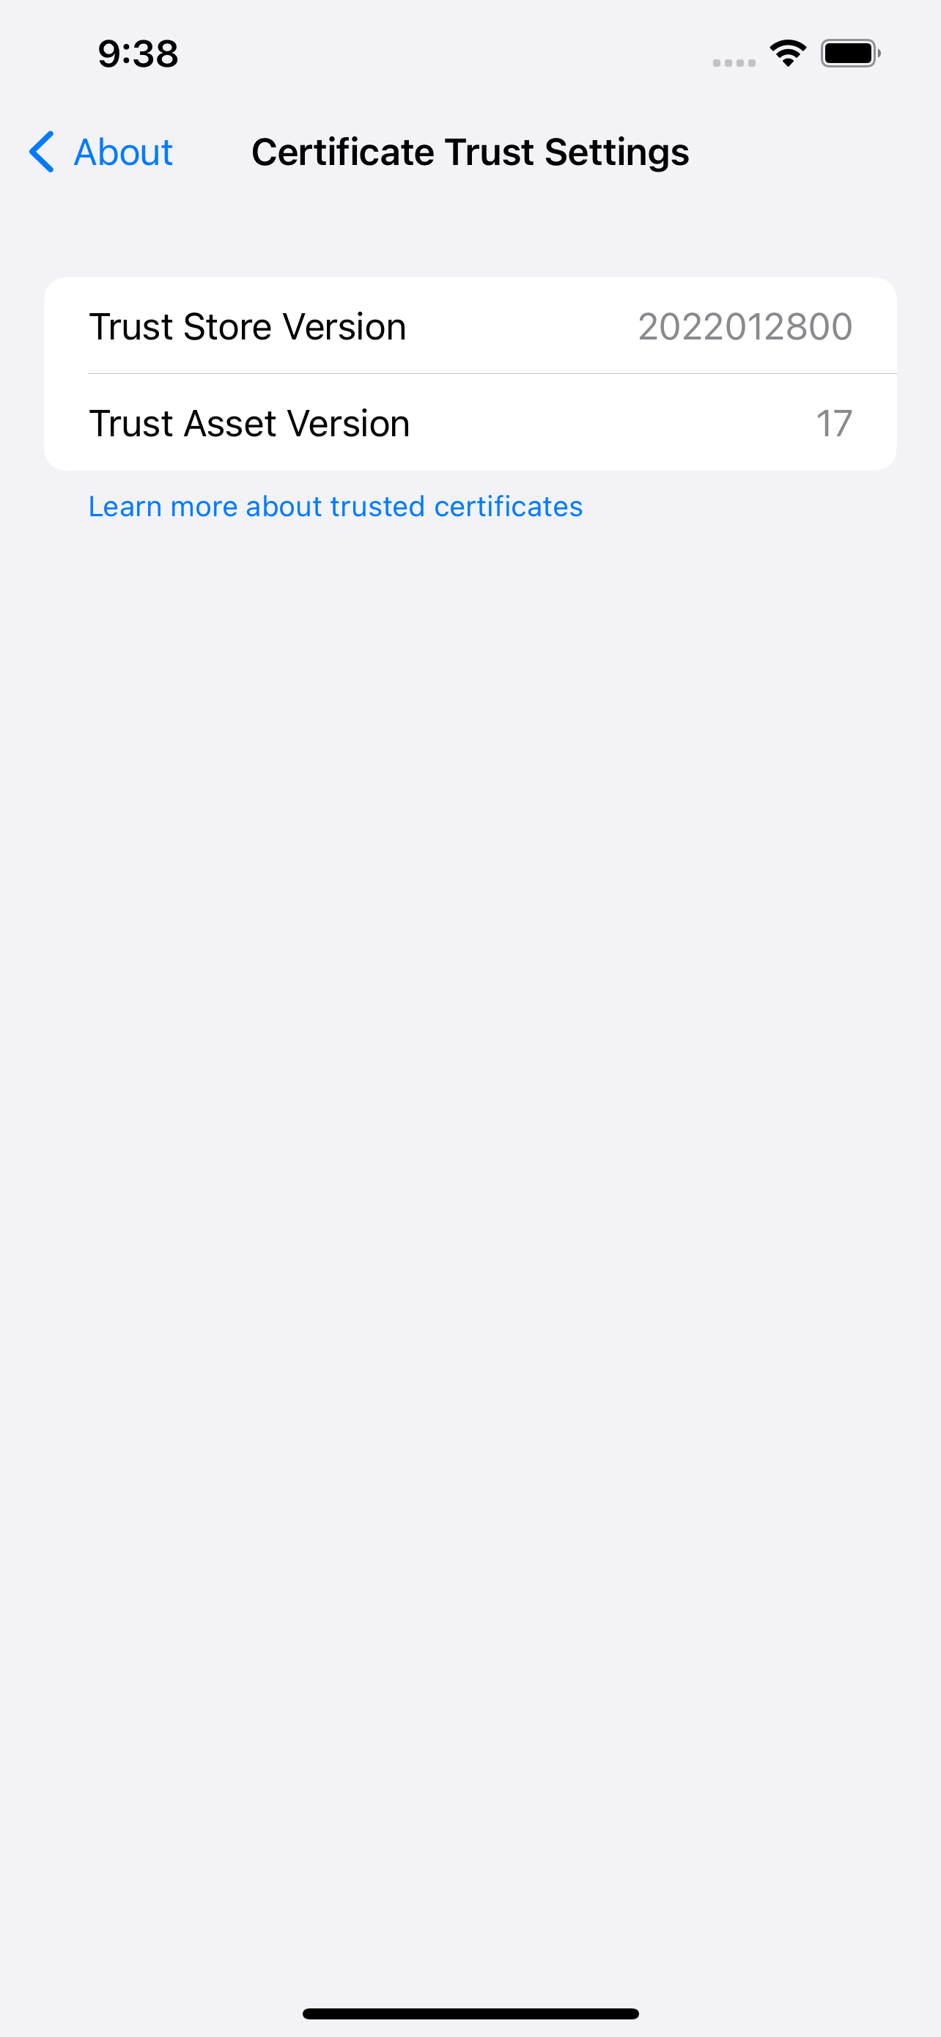
UINavigationController

Slide 9
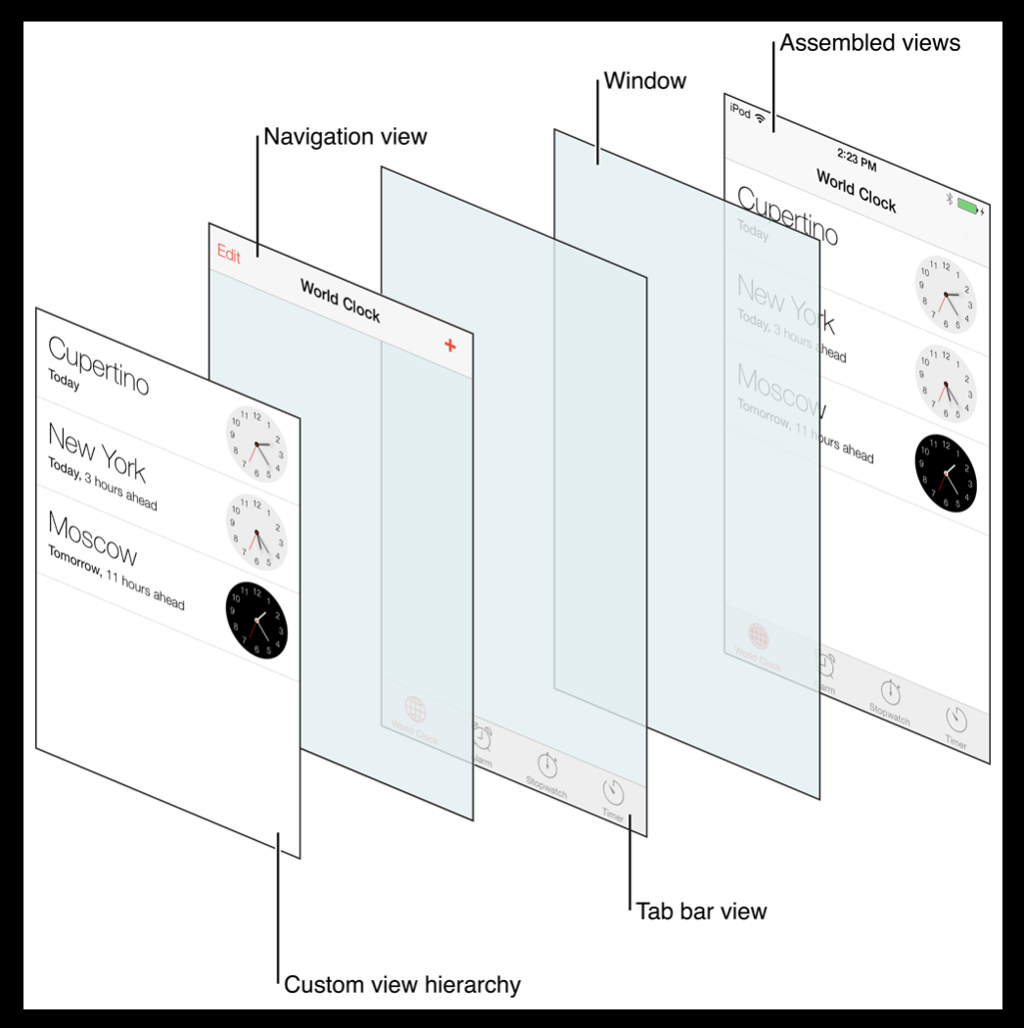
View Assembly

Slide 10
Accessing the sub-MVCs
By using viewControllers property.
For a tab bar, they are in an array left to right.
For a split view, first element is the master and second is the detail.
For a navigation controller, first element is the root view controller, and the rest are in order on the stack.
Every UIViewController knows it Split View, Tab Bar or Navigation Controller it is in.
UIViewController properties:
tabBarController: UITabBarController?
splitViewController: UISplitViewController?
navigationController: UINavigationController?

Slide 11
Segues
A segue defines a transition between two view controllers in your app’s storyboard file.
Segues always create a new instance of an MVC.
Kinds of segues:
Show – will push in a Navigation Controller, else Modal.
Show Detail – will show Detail of a Split View or will push in a Navigation Controller.
Modal – occupy the whole screen while the MVC is up.
Popover – make the MVC appear in a little popover window and disable outside area.
When you create a segue, give it an identifier.

Slide 12
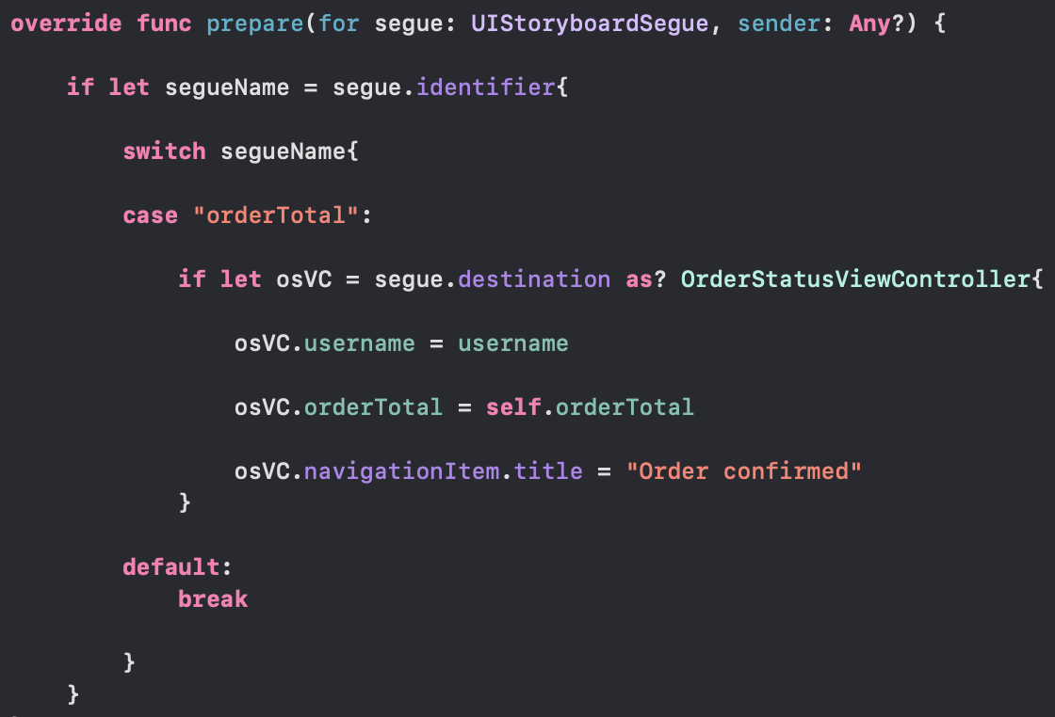
Preparing for a Segue
segue passed in contains important information.
the identifier.
the controller of the MVC you are segueing to.
sender is the object that initiated the segue.
The identifier is used to differentiate segues that your Controller might support. However, it can be nil also.
It is crucial to understand that this preparation is happening BEFORE outlets of the controller of the segued-to MVC get set.

Slide 13
Conclusion
Use UITabBarController to choose between different MVCs.
UISplitViewController puts two MVCs side-by-side.
UINavigationController pushes and pops MVCs off of a stack.
Segues always create a new instance of an MVC.

Slide 14
Reference
https://www.youtube.com/watch?v=RAcLKlwK7VY&list=PL3d_SFOiG7_8ofjyKzX6Nl1wZehbdiZC_&index=9

Slide 15
Multiple mvcs 44643 mobile Computing – iOS
Instructor: Dr. Chandra Mouli
Northwest Missouri State University

